Slide 1
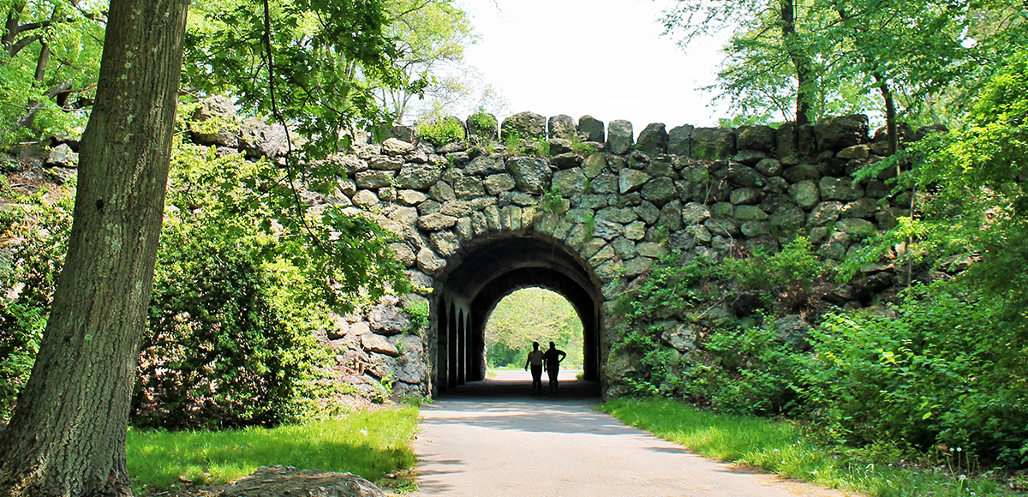
Predicting Invasive Understory Species Presence in Boston’s Deciduous Forests
Chad Fisher | UEP 294 | Final Project | 4.24.24
Notes:
https://www.tclf.org/sites/default/files/thumbnails/image/MA_Boston_FranklinPark_courtesyEmeraldNecklaceConservancy_2020_001_sig.jpg

Slide 2




Updated Research Question
How can supervised machine learning and harmonic regression be used to differentiate invasive and native understory species in Boston’s deciduous forests using 2023 Sentinel-2 data?

Slide 3
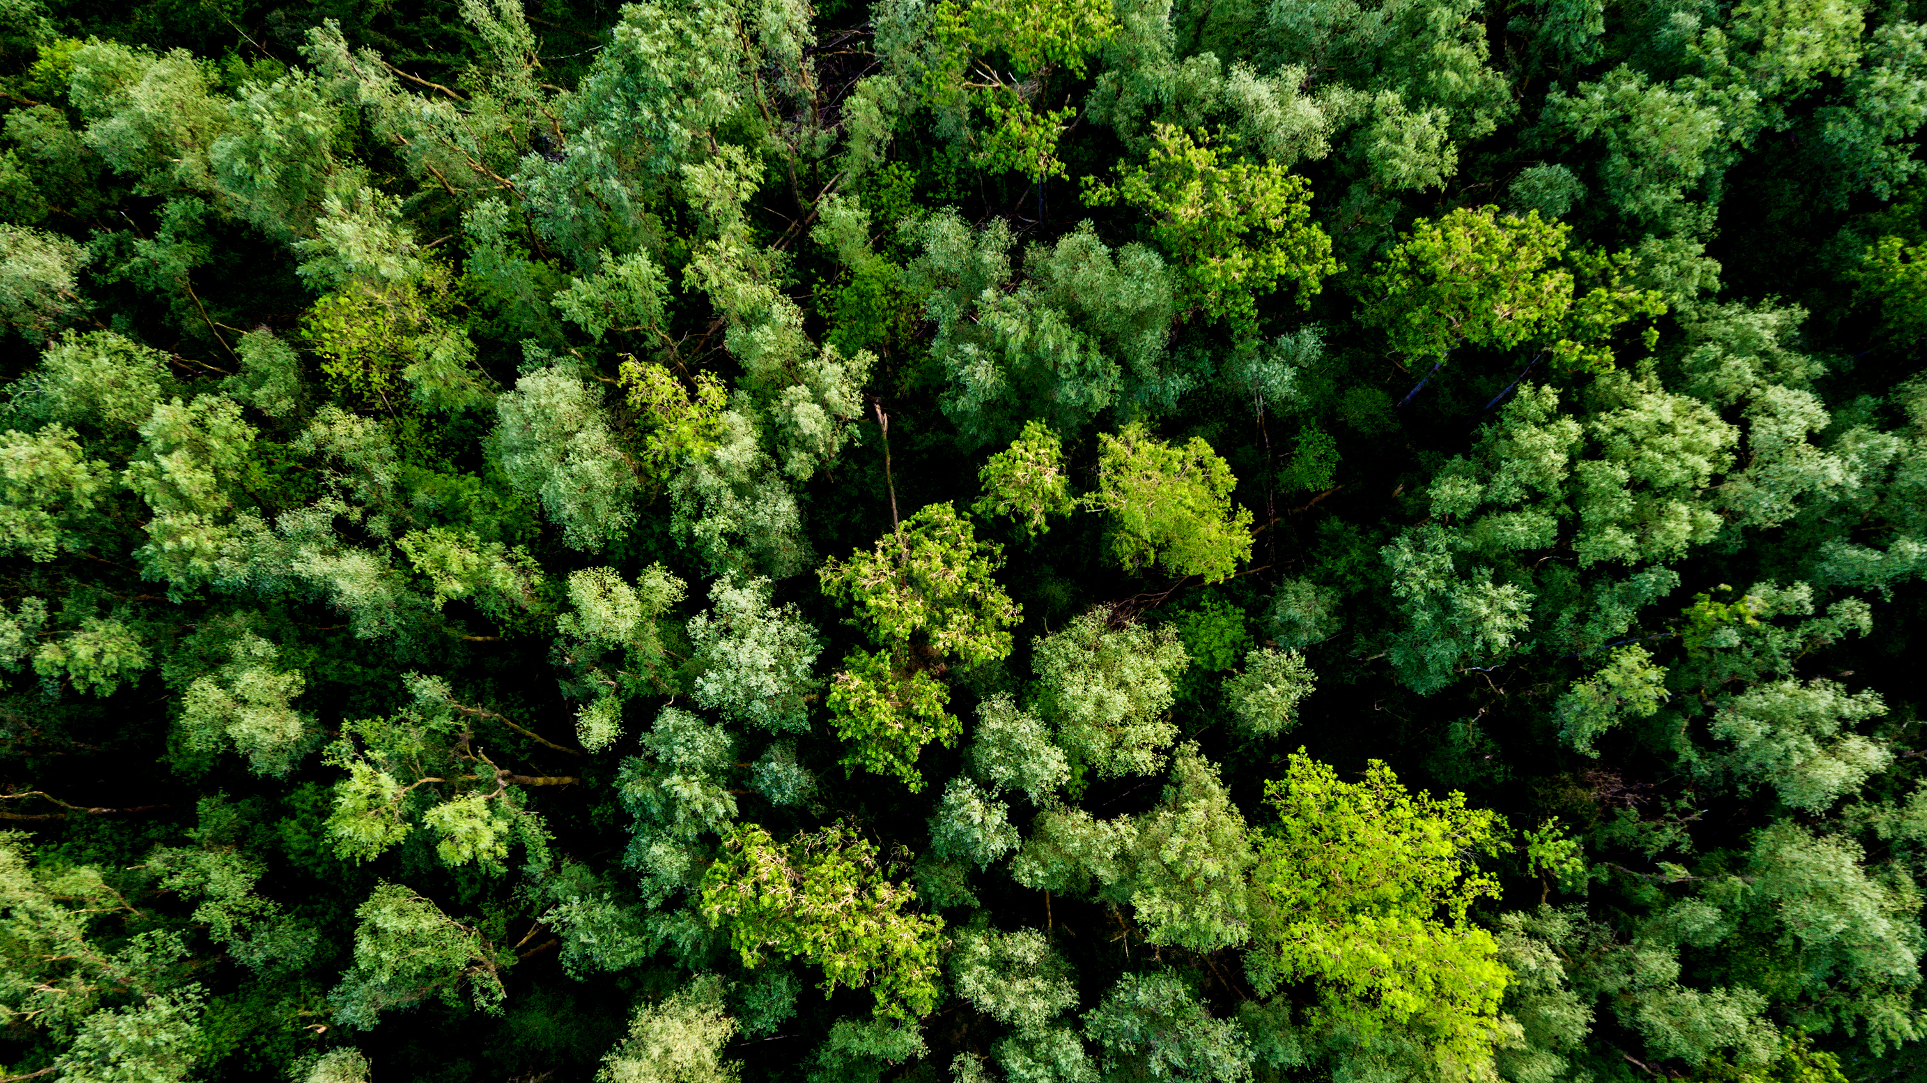
Methods

Slide 4
Preprocessing
1
2023 Sentinel-2 Data
2
Filter for <50% cloud coverage
3
Clip to Boston Deciduous Forests
4
Apply cloud mask
Mosaic same day images together
5

Slide 5
Extract Time Series Characteristics
1
Harmonic regression was performed pixelwise for each of the 10 bands and 4 indices using time series data
2
3
Reflectance
4
5
Day of the Year

Slide 6
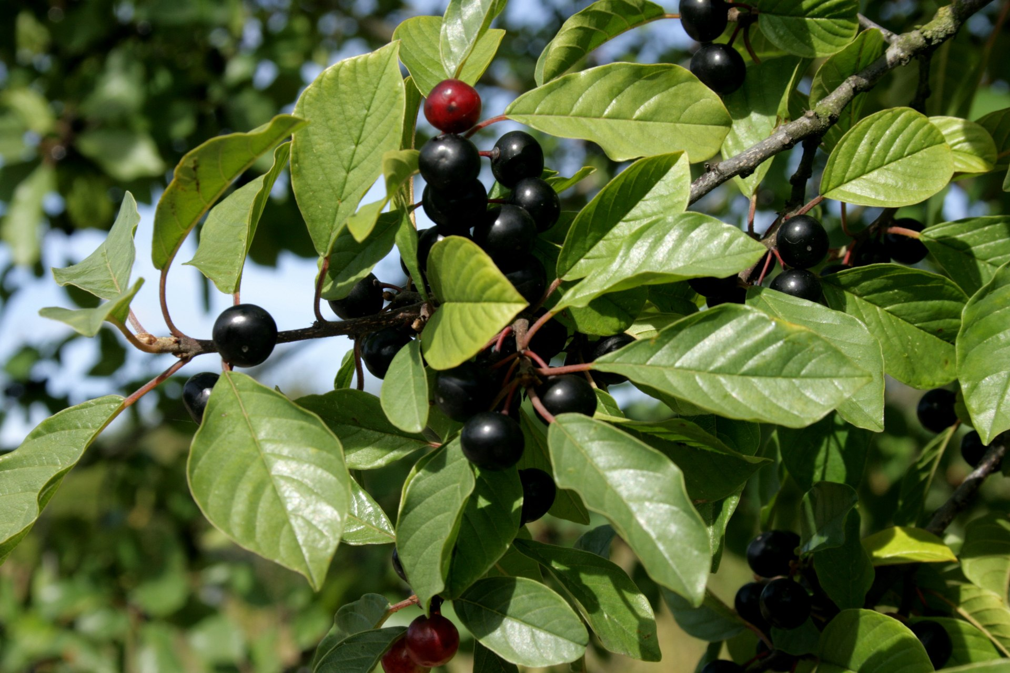
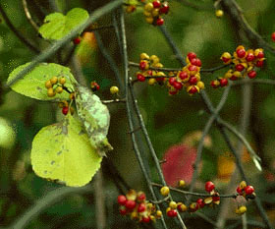
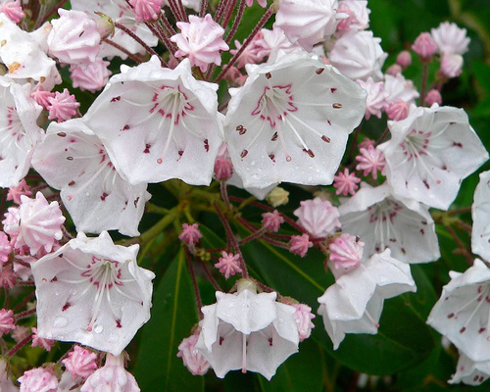
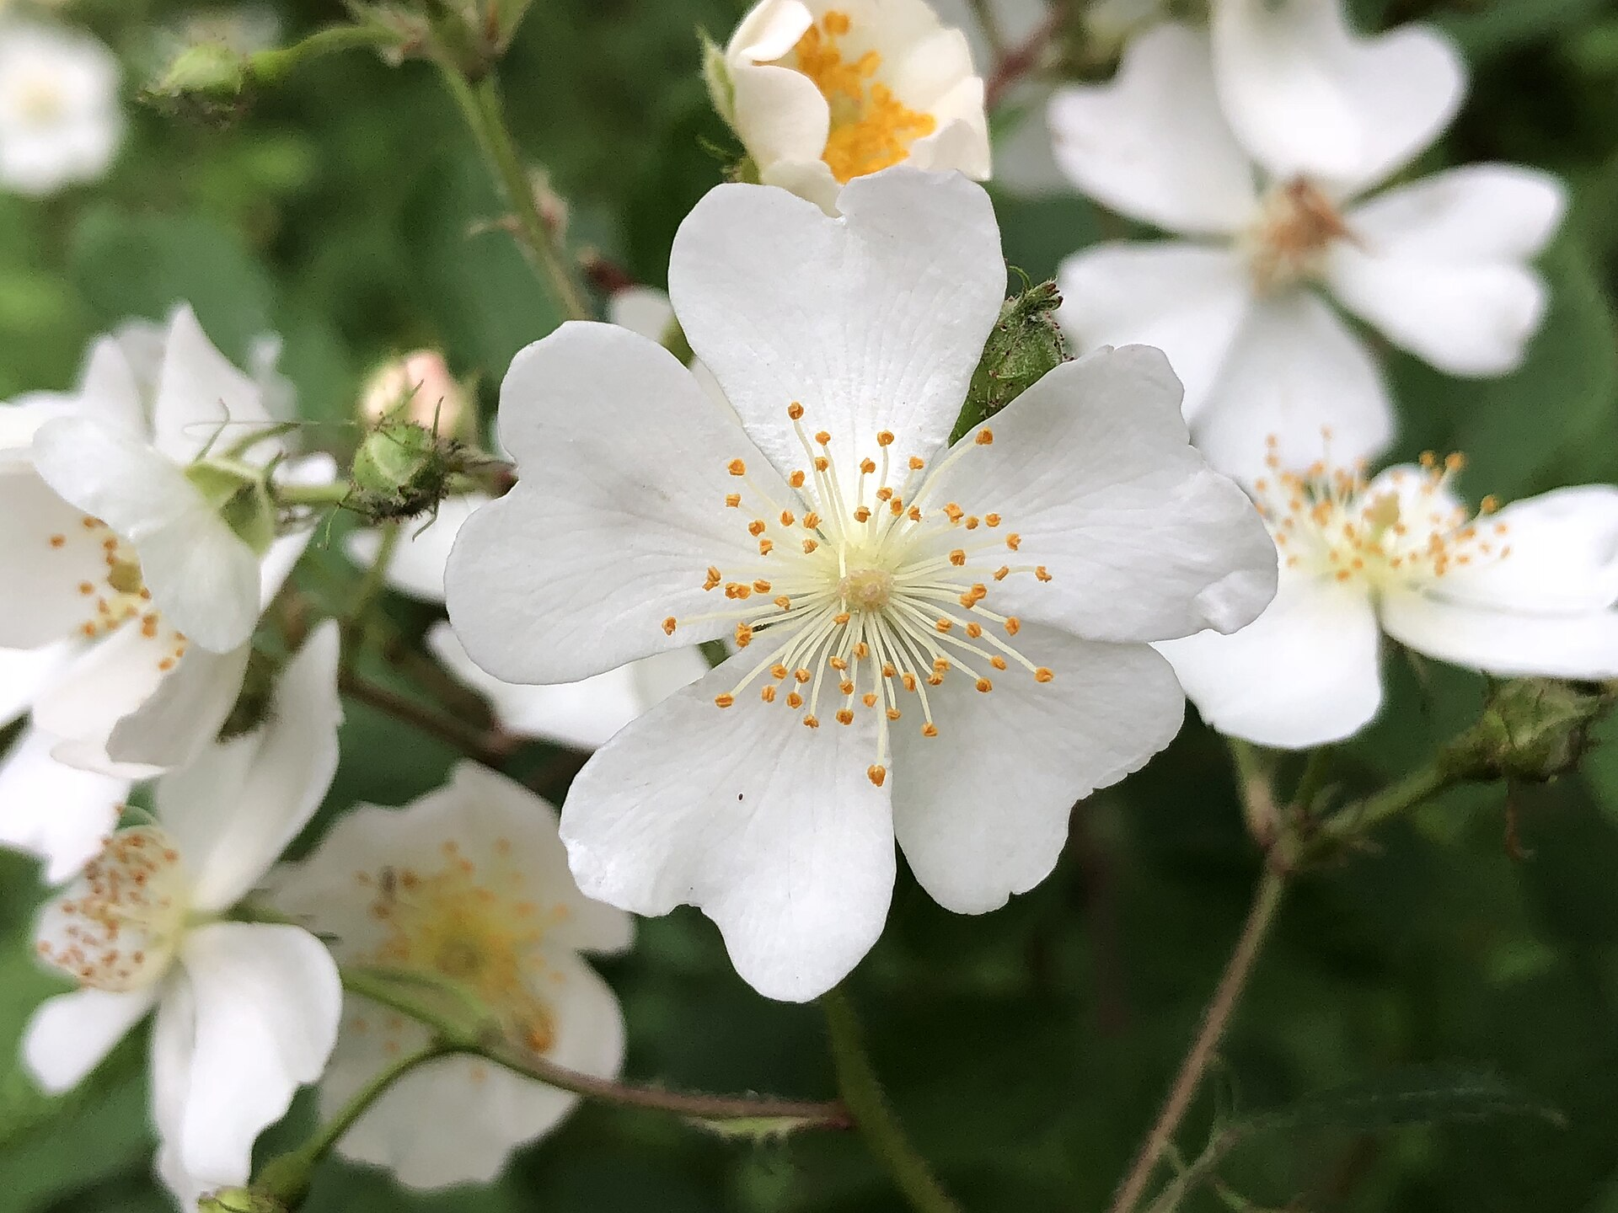
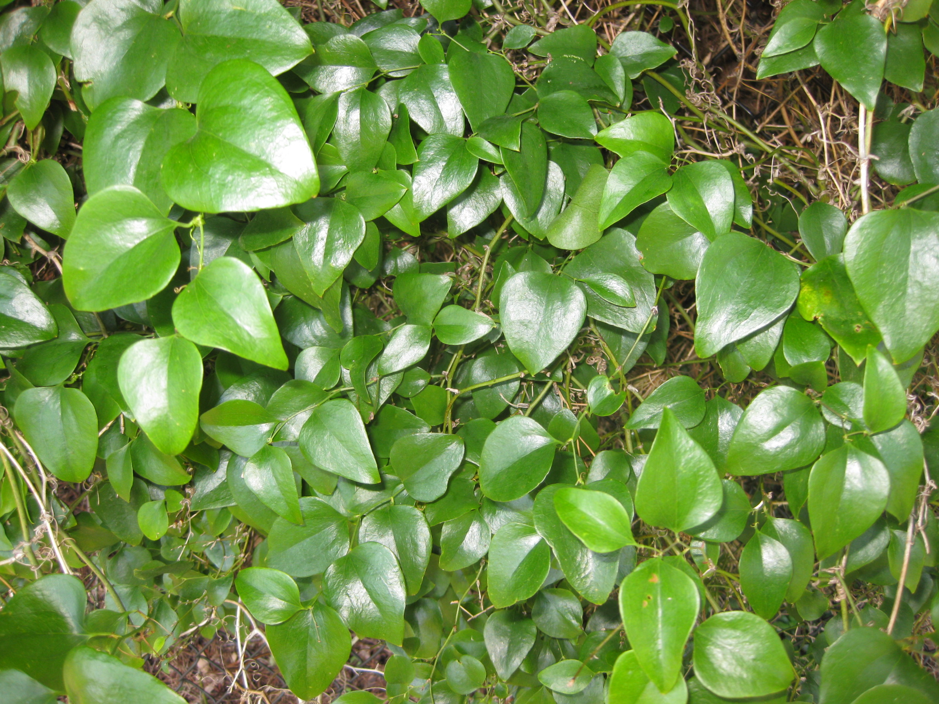
Training Data Collected
1
iNaturalist observations (2022 – present) extracted from their API of:
2
3 early invasives
2 important natives
3
Glossy Buckthorn
Frangula alnus
Asian Bittersweet
Celastrus orbiculatus
Mountain Laurel
Kalmia latifolia
4
5
Multiflora Rose
Rosa multiflora
Roundleaf Greenbrier
Smilax rotundifolia

Slide 7

Random Forest Classifiers
1
Implemented with GitHub package spatial RF from Mobility Information Engineering Lab at ETH Zürich
2
3
Used the 9 regression coefficients and the RMSE for the 10 bands and 4 indices resulting in 140 input variables
4
5

Slide 8
Validation and Prediction
1
2
Calculated accuracy information and confusion matrix for each classifier
&
Generated output map of predicted class for each 10 m pixel
3
4
5

Slide 9

Results

Slide 10
Images Selected
Jan
Feb
Mar
Apr
May
June
July
Aug
Sep
Oct
Nov
Dec
80 total images used

Slide 11
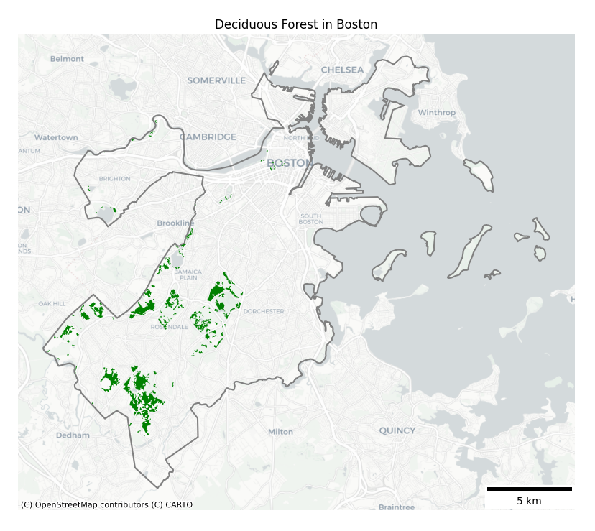
Study Area

Slide 12
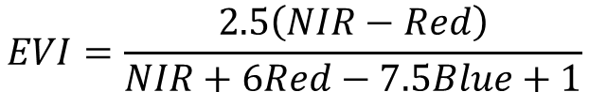
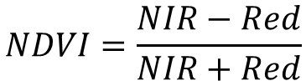
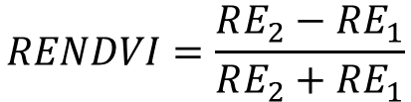
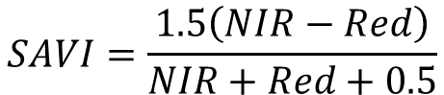
Selected Bands and Indices
Band | Wavelength
B2 | Red
B3 | Green
B4 | Blue
B5 | RE 1
B6 | RE 2
B7 | RE 3
B8 | NIR
B8A | RE 4
B11 | SWIR 1
B12 | SWIR 2
$$NDVI=\frac{NIR−Red}{NIR+Red}$$
$$RENDVI=\frac{RE_{2}−RE_{1}}{RE_{2}+RE_{1}}$$
$$SAVI=\frac{1.5\left(NIR−Red\right)}{NIR+Red+0.5}$$
$$EVI=\frac{2.5\left(NIR−Red\right)}{NIR+6Red−7.5Blue+1}$$

Slide 13
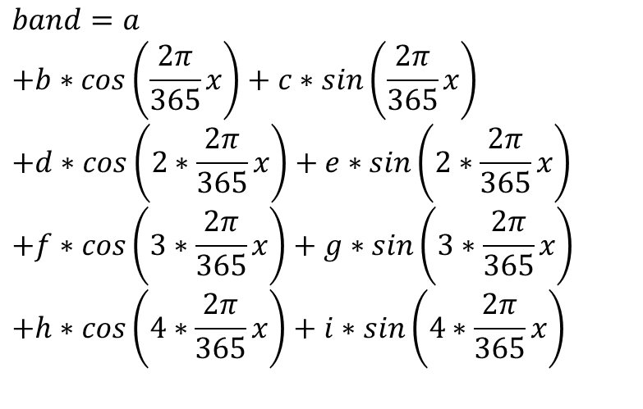
Harmonic Regression
$$band=a$$
$$+b∗cos\left(\frac{2π}{365}x\right)+c∗sin\left(\frac{2π}{365}x\right)$$
$$+d∗cos\left(2∗\frac{2π}{365}x\right)+e∗sin\left(2∗\frac{2π}{365}x\right)$$
$$+f∗cos\left(3∗\frac{2π}{365}x\right)+g∗sin\left(3∗\frac{2π}{365}x\right)$$
$$+h∗cos\left(4∗\frac{2π}{365}x\right)+i∗sin\left(4∗\frac{2π}{365}x\right)$$

Slide 14
Harmonic Regression
Seasonality:
$$band=a$$
$$+b∗cos\left(\frac{2π}{365}x\right)+c∗sin\left(\frac{2π}{365}x\right)$$
$$+d∗cos\left(2∗\frac{2π}{365}x\right)+e∗sin\left(2∗\frac{2π}{365}x\right)$$
$$+f∗cos\left(3∗\frac{2π}{365}x\right)+g∗sin\left(3∗\frac{2π}{365}x\right)$$
$$+h∗cos\left(4∗\frac{2π}{365}x\right)+i∗sin\left(4∗\frac{2π}{365}x\right)$$
Yearly

Slide 15
Harmonic Regression
Seasonality:
$$band=a$$
$$+b∗cos\left(\frac{2π}{365}x\right)+c∗sin\left(\frac{2π}{365}x\right)$$
$$+d∗cos\left(2∗\frac{2π}{365}x\right)+e∗sin\left(2∗\frac{2π}{365}x\right)$$
$$+f∗cos\left(3∗\frac{2π}{365}x\right)+g∗sin\left(3∗\frac{2π}{365}x\right)$$
$$+h∗cos\left(4∗\frac{2π}{365}x\right)+i∗sin\left(4∗\frac{2π}{365}x\right)$$
Yearly
6-month

Slide 16
Harmonic Regression
Seasonality:
$$band=a$$
$$+b∗cos\left(\frac{2π}{365}x\right)+c∗sin\left(\frac{2π}{365}x\right)$$
$$+d∗cos\left(2∗\frac{2π}{365}x\right)+e∗sin\left(2∗\frac{2π}{365}x\right)$$
$$+f∗cos\left(3∗\frac{2π}{365}x\right)+g∗sin\left(3∗\frac{2π}{365}x\right)$$
$$+h∗cos\left(4∗\frac{2π}{365}x\right)+i∗sin\left(4∗\frac{2π}{365}x\right)$$
Yearly
6-month
4-month

Slide 17
Harmonic Regression
Seasonality:
$$band=a$$
$$+b∗cos\left(\frac{2π}{365}x\right)+c∗sin\left(\frac{2π}{365}x\right)$$
$$+d∗cos\left(2∗\frac{2π}{365}x\right)+e∗sin\left(2∗\frac{2π}{365}x\right)$$
$$+f∗cos\left(3∗\frac{2π}{365}x\right)+g∗sin\left(3∗\frac{2π}{365}x\right)$$
$$+h∗cos\left(4∗\frac{2π}{365}x\right)+i∗sin\left(4∗\frac{2π}{365}x\right)$$
Yearly
6-month
4-month
3-month

Slide 18
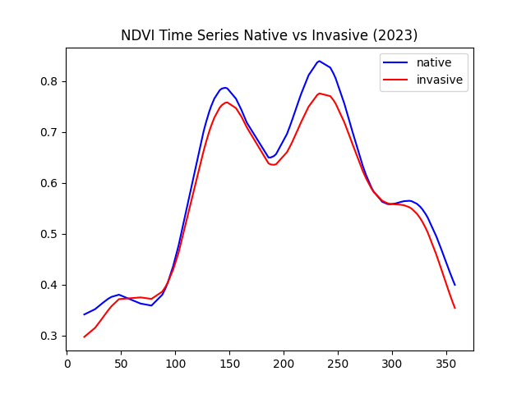
Harmonic Regression
scipy.optimize.curve_fit()
(non-linear least squares regression)
Seasonality:
$$band=a$$
$$+b∗cos\left(\frac{2π}{365}x\right)+c∗sin\left(\frac{2π}{365}x\right)$$
$$+d∗cos\left(2∗\frac{2π}{365}x\right)+e∗sin\left(2∗\frac{2π}{365}x\right)$$
$$+f∗cos\left(3∗\frac{2π}{365}x\right)+g∗sin\left(3∗\frac{2π}{365}x\right)$$
$$+h∗cos\left(4∗\frac{2π}{365}x\right)+i∗sin\left(4∗\frac{2π}{365}x\right)$$
Yearly
6-month
4-month
3-month

Slide 19
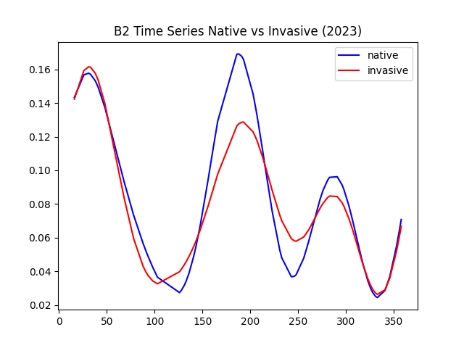
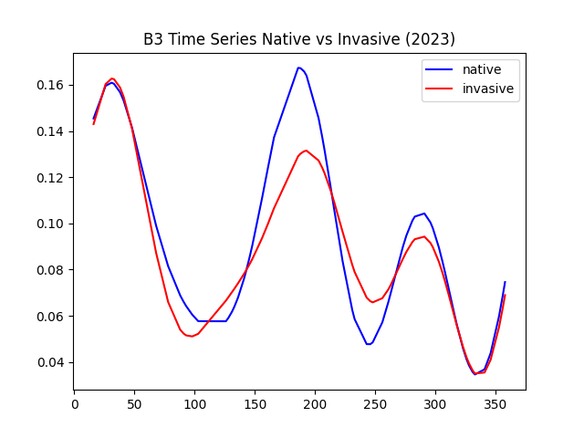
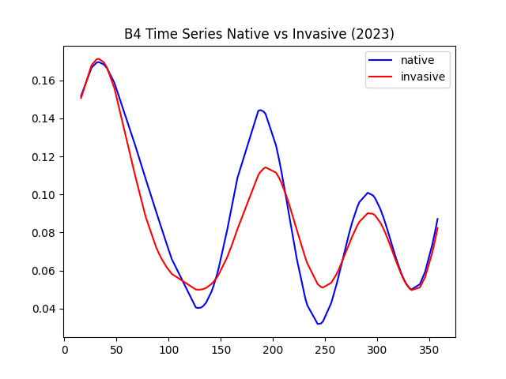
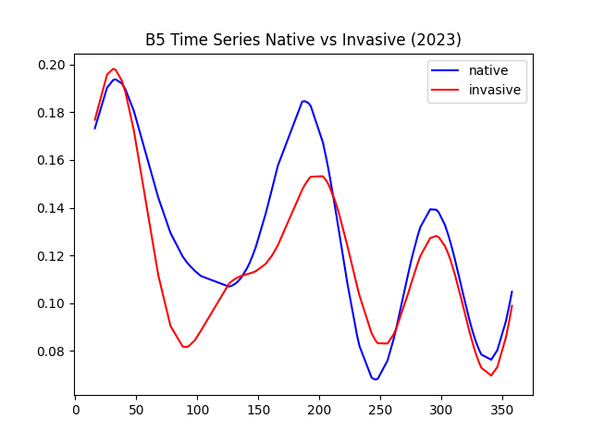
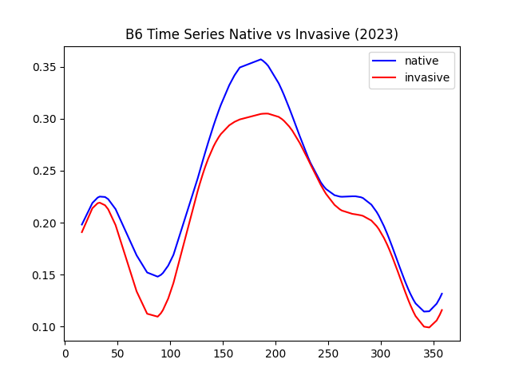
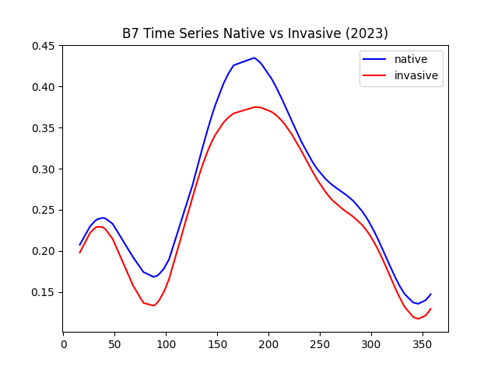
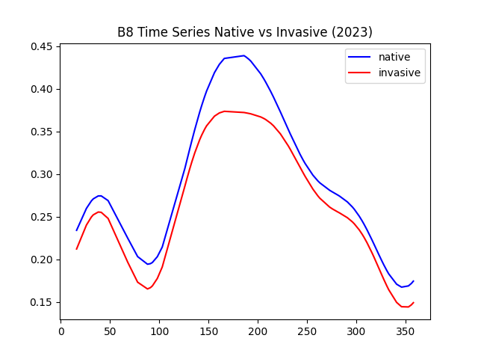
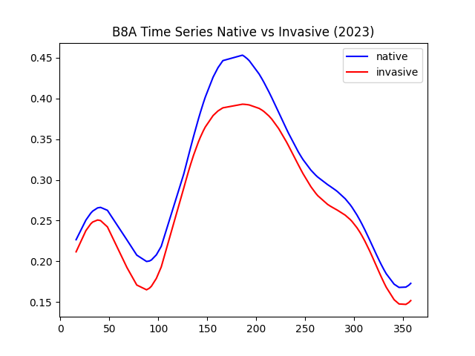
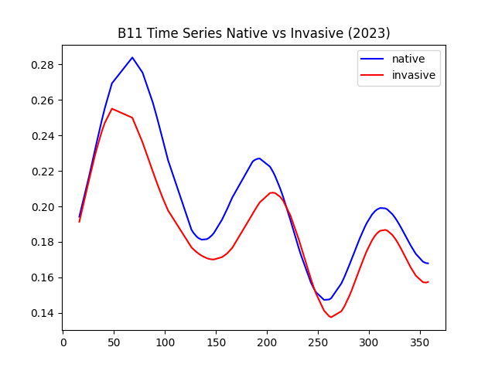
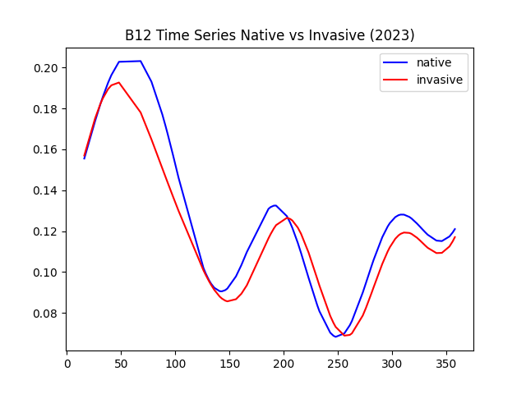
Regressions for Bands

Slide 20
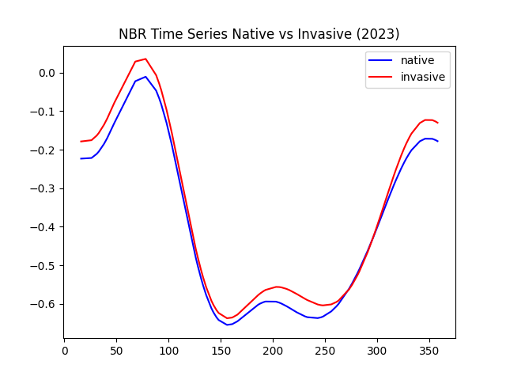
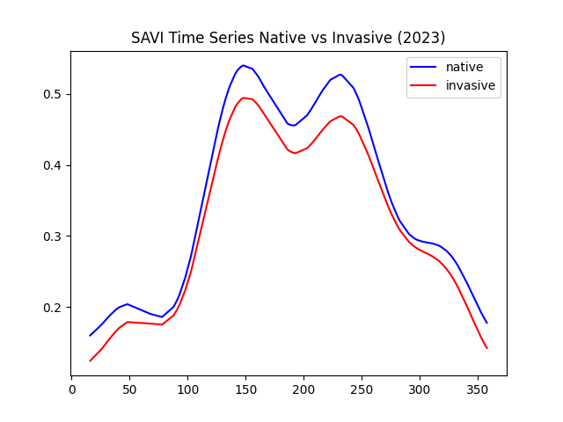
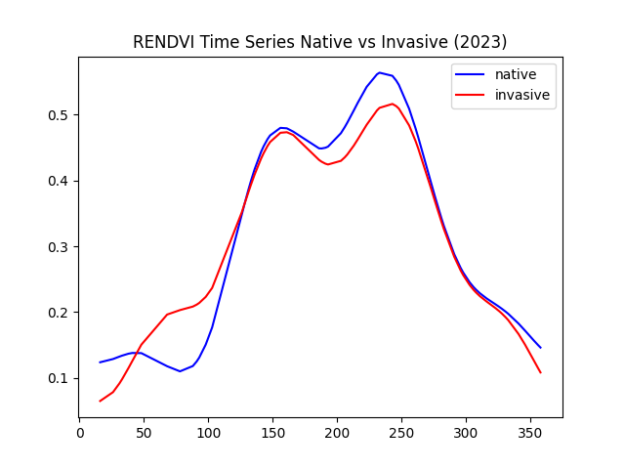
Regressions for Indices

Slide 21
Regressions for Indices

Slide 22
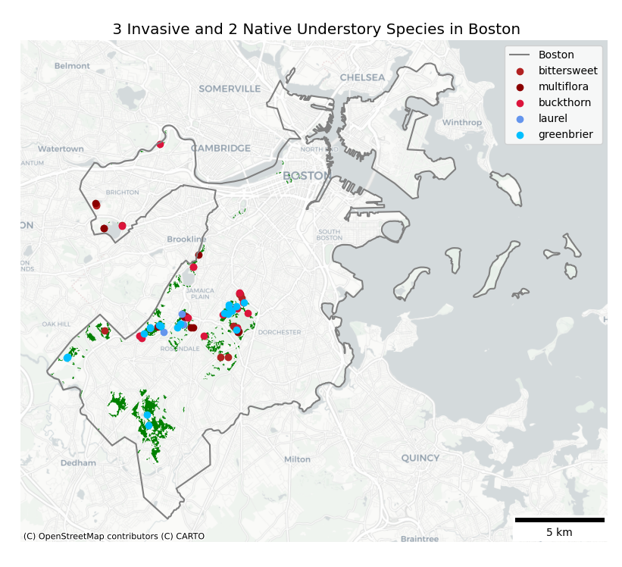
iNaturalist Training Sites

Slide 23
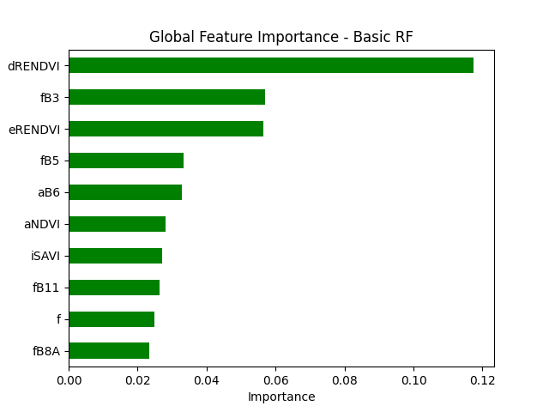
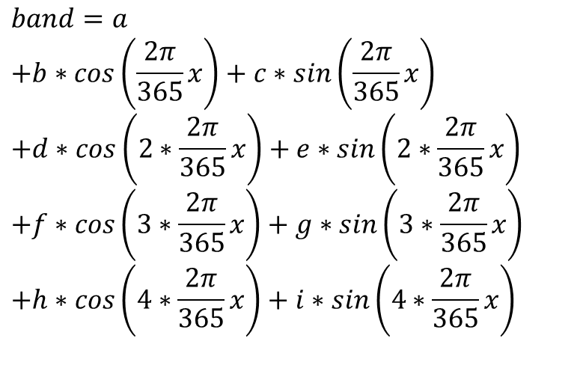
Feature Importance
$$band=a$$
$$+b∗cos\left(\frac{2π}{365}x\right)+c∗sin\left(\frac{2π}{365}x\right)$$
$$+d∗cos\left(2∗\frac{2π}{365}x\right)+e∗sin\left(2∗\frac{2π}{365}x\right)$$
$$+f∗cos\left(3∗\frac{2π}{365}x\right)+g∗sin\left(3∗\frac{2π}{365}x\right)$$
$$+h∗cos\left(4∗\frac{2π}{365}x\right)+i∗sin\left(4∗\frac{2π}{365}x\right)$$

Slide 24
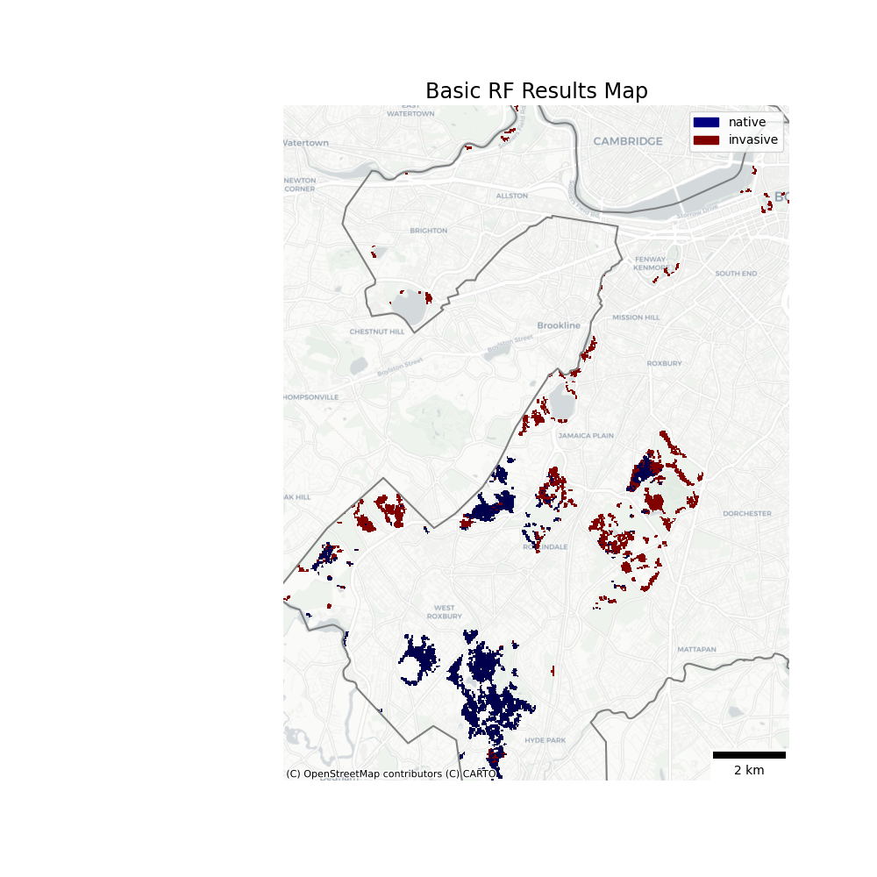
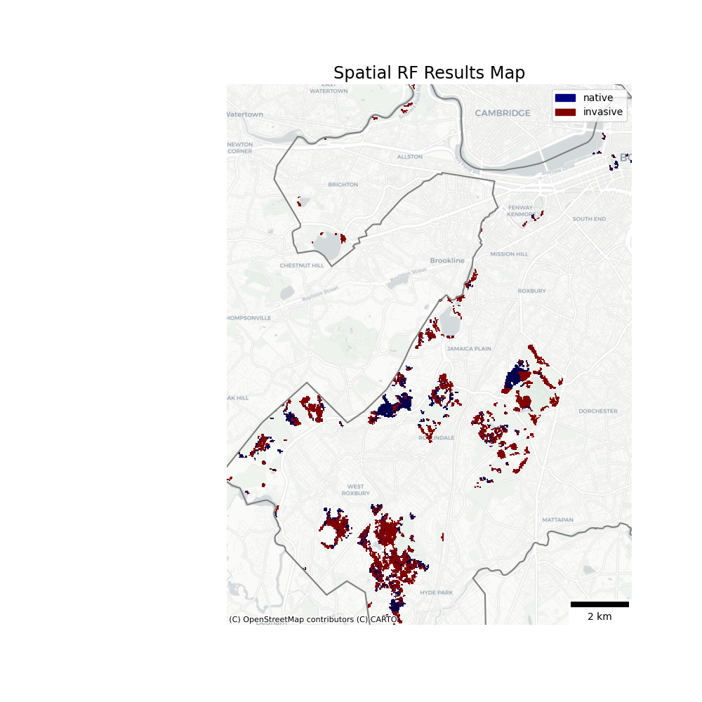
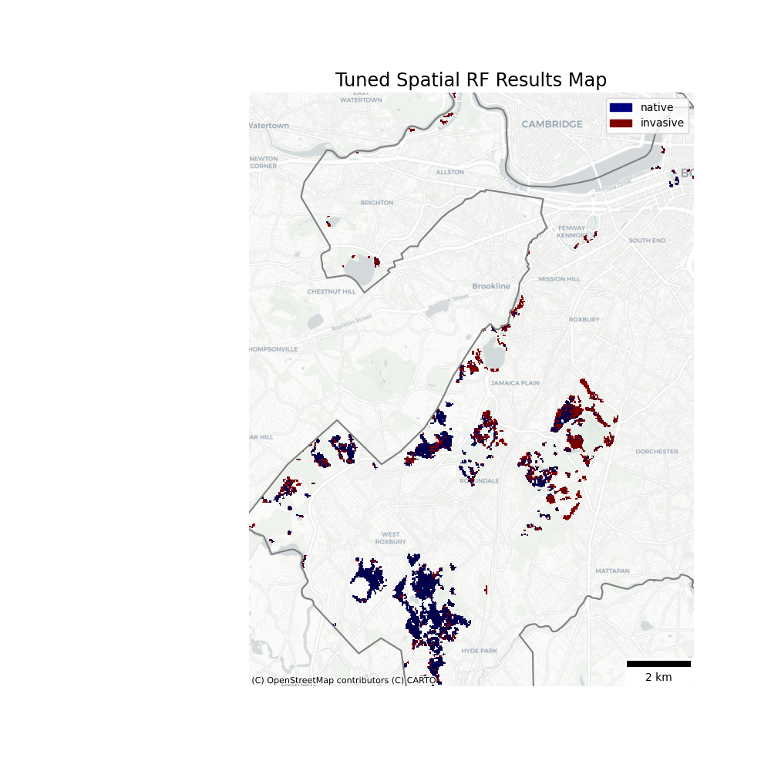
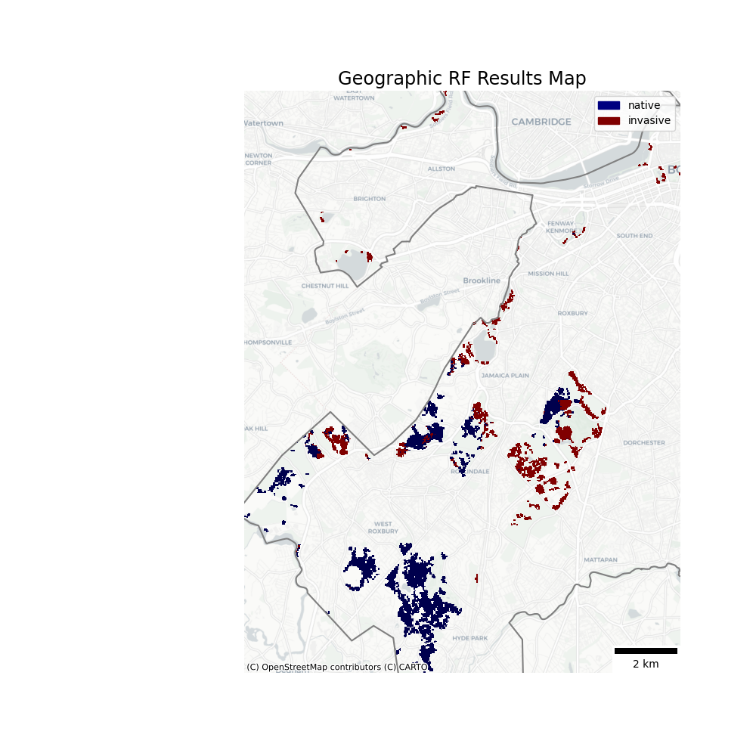
Random Forest Results

Slide 25
Accuracy Metrics
Model | Producer’s Accuracy (natives, invasives) | User’s Accuracy (natives, invasives) | Overall Accuracy | Kappa | Predicted Coverage by Invasives
Basic | 81%, 100% | 100%, 86% | 91.1% | 0.82 | 41.3%
Spatial | 66.7%, 100% | 100%, 77.4% | 84.4% | 0.68 | 71.0%
Spatial, tuned | 76.2%, 95.8% | 94.1%, 82.1% | 86.7% | 0.73 | 34.6%
Geographic | 85.7%, 100% | 100%, 88.9% | 93.3% | 0.86 | 34.1%

Slide 26
Runtime for Using Model to Predict
Model | Run Time (ms)
Basic | 92
Spatial | 1690
Spatial, tuned | 1580
Geographic | 151,000

Slide 27

Main Takeaway
34%
of Boston’s deciduous forest is expected to have invasive understory species

Slide 28
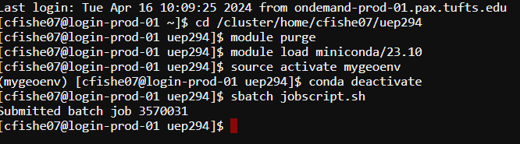
Limitations
Biased/non-representative training data ← iNaturalist
Can’t distinguish between species
Non-target confounding species presence
Some areas vary widely in their predicted classification
Perhaps a probability output would be more useful?
Forest areas in Boston are highly fragmented and may require higher spatial resolution for accurate results
Practical constraints on this workflow due to computer runtime and memory limits

Slide 29
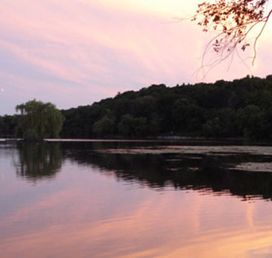
Further Work…
Developing a geographic random forest classifier than can distinguish different species
Expanding to the rest of the watershed
Adding a way to extract feature importance from spatial/geographic RFs
More field data collection for a larger and more representative sample
Notes:
https://www.emeraldnecklace.org/park-overview/jamaica-pond/

Slide 30
Predicting Invasive Understory Species Presence in Boston’s Deciduous Forests
Chad Fisher | UEP 294 | Final Project | 4.24.24
Notes:
https://www.tclf.org/sites/default/files/thumbnails/image/MA_Boston_FranklinPark_courtesyEmeraldNecklaceConservancy_2020_001_sig.jpg

Slide 31
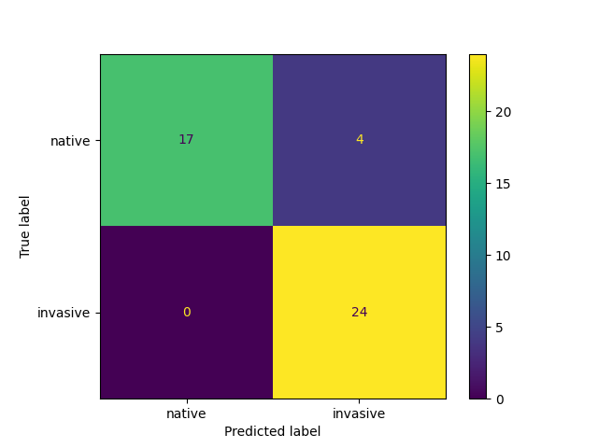
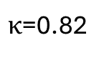
$κ$=0.82
User’s Accuracy: 100% for native, 86% for invasive
Producer’s Accuracy: 100% for invasive, 81% for native
Overall Accuracy: 91%

Slide 32
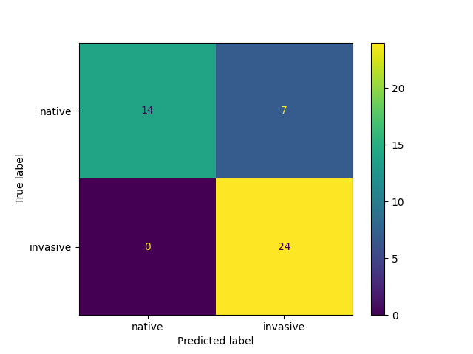
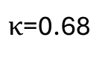
$κ$=0.68
User’s Accuracy: 100% for native, 77% for invasive
Producer’s Accuracy: 100% for invasive, 67% for native
Overall Accuracy: 84%

Slide 33
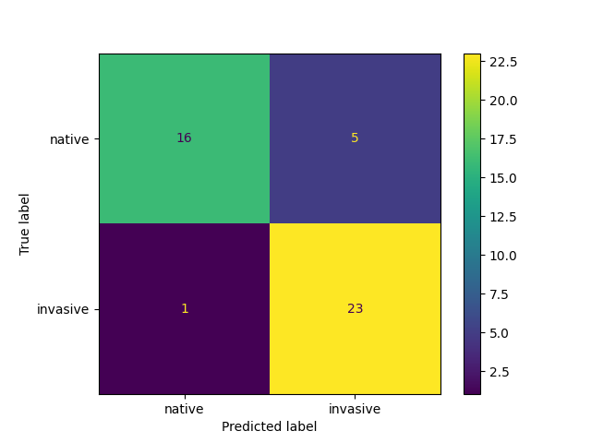
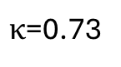
$κ$=0.73
User’s Accuracy: 76.2% for native, 95.8% for invasive
Producer’s Accuracy: 94.1% for invasive, 82.1% for native
Overall Accuracy: 86.7%

Slide 34
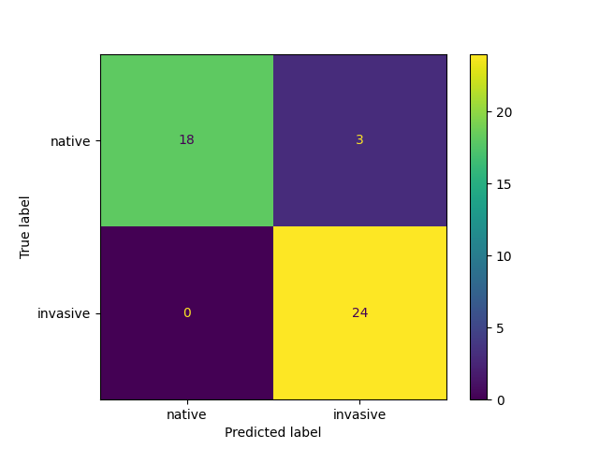
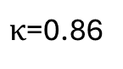
$κ$=0.86
User’s Accuracy: 85.7% for native, 100% for invasive
Producer’s Accuracy: 100% for invasive, 88.9% for native
Overall Accuracy: 93.3%

